Slide 1
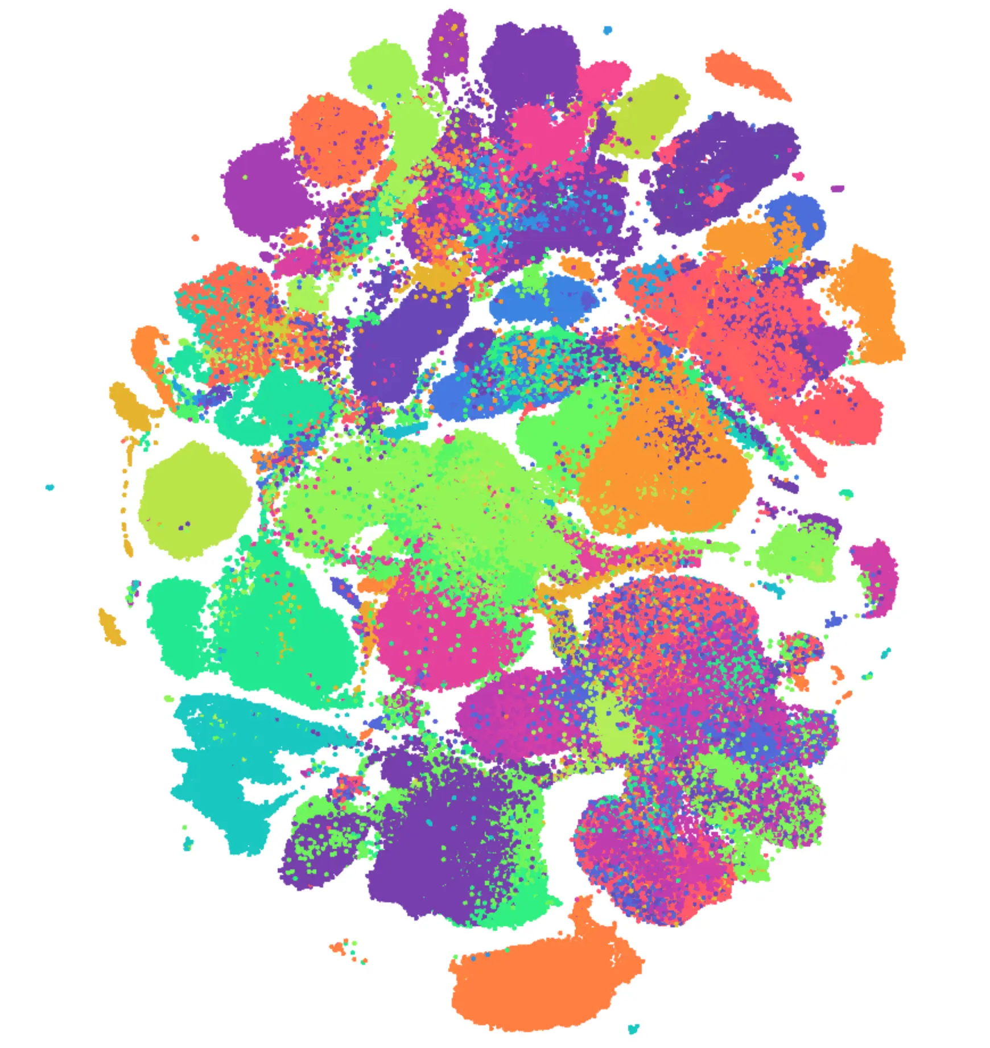
CellXGene: A Powerful Tool for Spatial Transcriptomics
+
Interfacing CellXGene with Seurat
Dennis Hamrick

Slide 2
What is CellXGene?
CellXGene is an open source tool for publishing and analysing spatial and single-cell datasets.
CellXGene allows you to easily access and analyze many public spatial transcriptomics datasets, as well as many single-cell transcriptomics datasets.
You can also use CellXGene for publishing and graphically interacting with your own data.

Slide 3
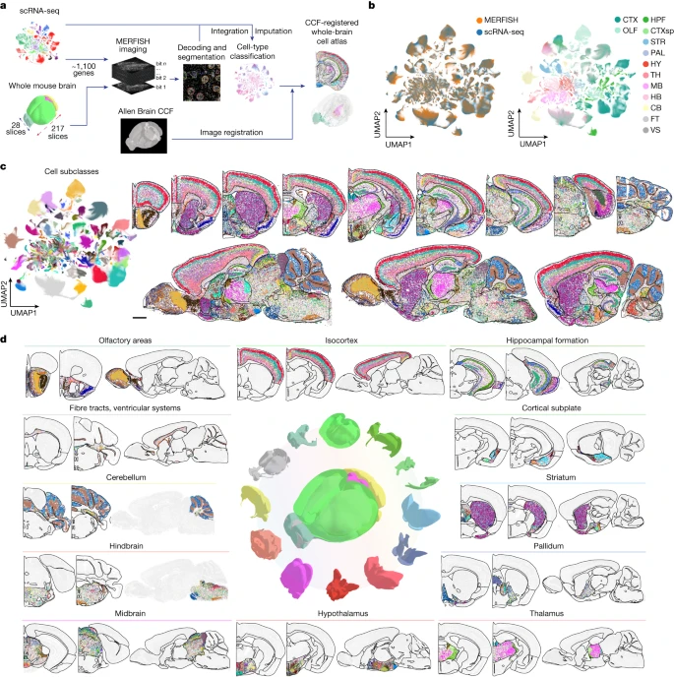
What datasets are available?
In 2023, Zhang et al. published a MERFISH atlas of the whole mouse brain.
Data is available on CellXGene.
1124 genes, markers for most major cell types.
Several different brains available (coronal/sagittal sections)

Slide 4
What datasets are available?
This talk will use one brain from the Zhang dataset as an example, but there are thousands of other datasets available on CellXGene.
Every major organ
Developmental atlases
Various species/model organisms

Slide 5

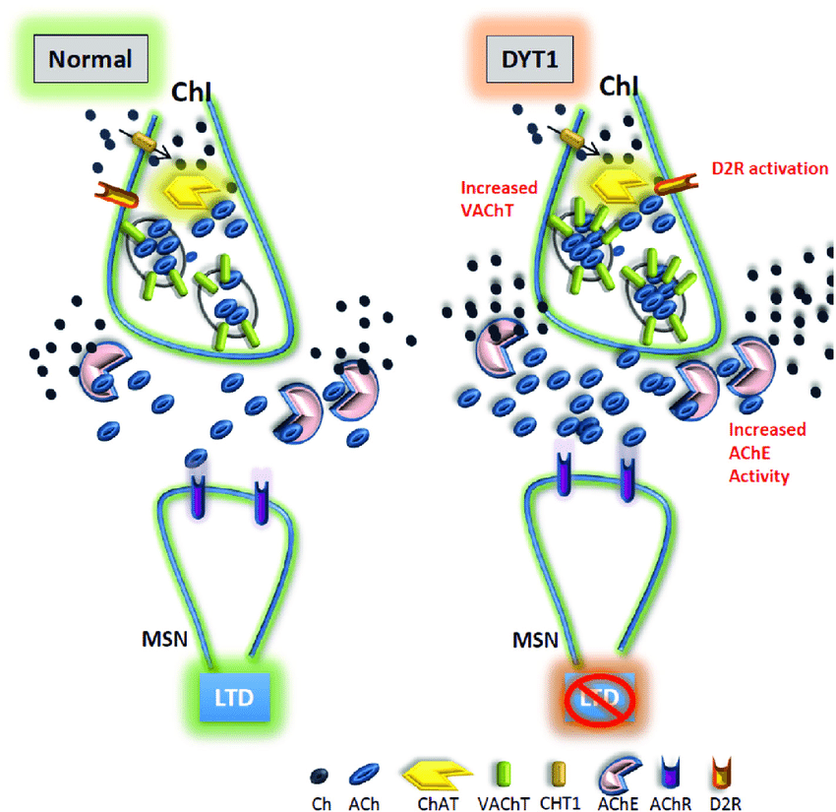
What questions can we answer with CellXGene/the Zhang Atlas?
DYT1 dystonia is a congenital movement disorder characterized by involuntary twisting movements.
A mutation in the gene TorsinA is implicated. This mutation causes death of cholinergic neurons in the striatum.
This effect is not complete – some striatal cholinergic neurons are unaffected, and there are spatial biases for which cells die.

Slide 6
Interfacing CellXGene With Seurat
Identify and select cells of interest in CxG
Port CxG data into Seurat, interact with it as a Seurat object
Port back into CxG, visualize spatial arrangement of clusters

Slide 7
Demo

